Slide 1


AMAZON.COM
PRASHANT UPADHYAY
AMAZON ANALYSIS
26 AUGUST 2025

Slide 2
amazon
AMAZON, FOUNDED BY JEFF BEZOS IN 1994 AS AN ONLINE BOOKSTORE, HAS GROWN INTO ONE OF THE WORLD’S LARGEST MULTINATIONAL TECHNOLOGY COMPANIES. HEADQUARTERED IN SEATTLE, USA, AMAZON OPERATES ACROSS E-COMMERCE, CLOUD COMPUTING, DIGITAL STREAMING, AND ARTIFICIAL INTELLIGENCE. ITS FLAGSHIP PLATFORM, AMAZON.COM, REVOLUTIONIZED RETAIL BY OFFERING A WIDE RANGE OF PRODUCTS WITH FAST DELIVERY, SUPPORTED BY INNOVATIONS LIKE PRIME MEMBERSHIP AND AN ADVANCED GLOBAL LOGISTICS NETWORK. BEYOND E-COMMERCE, AMAZON WEB SERVICES (AWS) HAS BECOME A LEADER IN CLOUD COMPUTING, SERVING STARTUPS, ENTERPRISES, AND GOVERNMENTS WORLDWIDE. THE COMPANY ALSO OWNS ALEXA, KINDLE, AUDIBLE, AND STREAMING SERVICE PRIME VIDEO. AMAZON EMPHASIZES CUSTOMER OBSESSION, OPERATIONAL EXCELLENCE, AND INNOVATION AS ITS CORE PRINCIPLES. WITH A MARKET PRESENCE IN MULTIPLE COUNTRIES, AMAZON HAS TRANSFORMED SHOPPING HABITS AND CONTINUES TO REDEFINE INDUSTRIES THROUGH TECHNOLOGY, DATA-DRIVEN DECISIONS, AND EXPANSION INTO AREAS LIKE AUTOMATION, ROBOTICS, AND SUSTAINABILITY INITIATIVES.

Slide 3
Agenda
THE AGENDA OF THIS AMAZON E-COMMERCE ANALYTICS PROJECT IS TO DERIVE VALUABLE INSIGHTS FROM ORDERS, PRODUCTS, AND CUSTOMER DATA TO SUPPORT STRATEGIC DECISION-MAKING. THE PROJECT BEGINS WITH DATA PREPARATION, INCLUDING CLEANING, TRANSFORMATION, AND MODELING OF DATASETS FROM MULTIPLE SOURCES. IT THEN FOCUSES ON ORDER AND PRODUCT ANALYSIS TO IDENTIFY TOP-SELLING PRODUCTS, CATEGORY-WISE REVENUE, AND PAYMENT METHOD PREFERENCES. SALES PERFORMANCE IS STUDIED THROUGH MONTHLY SALES TRENDS, COD VS PREPAID PERFORMANCE, AND OVERALL REVENUE GROWTH. CUSTOMER INSIGHTS SUCH AS REPEAT PURCHASE BEHAVIOR, NEW CUSTOMER ACQUISITION, AND PRODUCT RETURN RATES ARE ALSO HIGHLIGHTED. FINALLY, INTERACTIVE DASHBOARDS IN POWER BI, ENHANCED WITH BUTTONS, SLICERS, AND URL ICONS, ALONGSIDE PYTHON VISUALIZATIONS, BRING THE ANALYSIS TO LIFE.

Slide 4
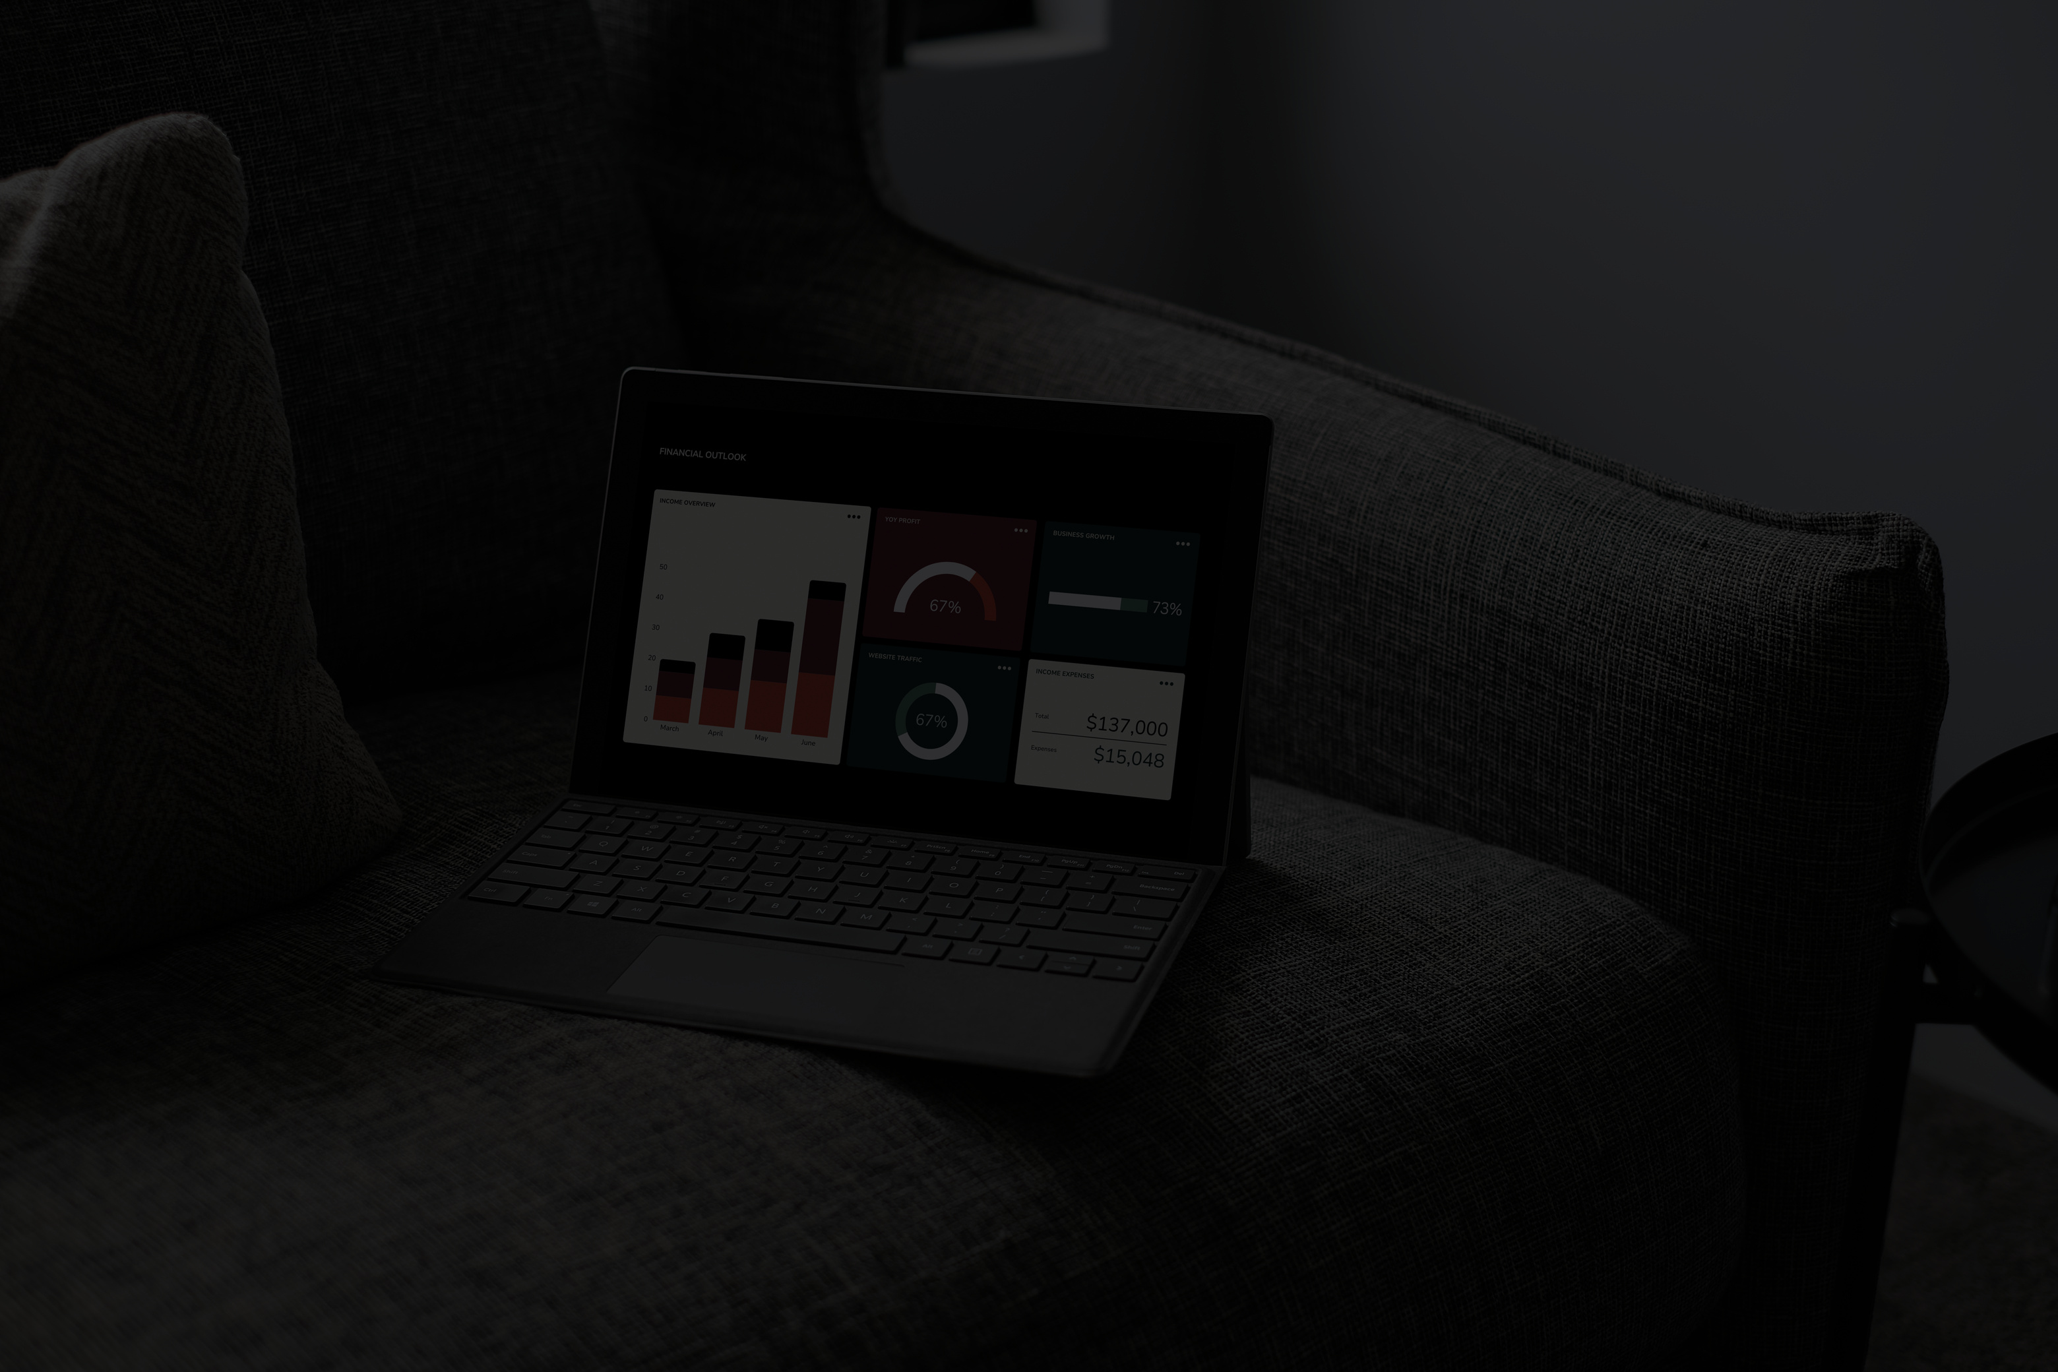

PROJECT OVERVIEW
📂 DATA SOURCES
ORDERS DATA – ORDER DETAILS, STATUS, PAYMENT METHODS, REVENUE.
PRODUCT DATA – PRODUCT NAMES, CATEGORIES, PRICING.
CUSTOMER REVIEWS – RATINGS ON QUALITY, DELIVERY, AND PACKAGING.
📊 KEY ANALYSIS AREAS
ORDER & PRODUCT INSIGHTS → TOP-SELLING PRODUCTS, SALES BY CATEGORY, AND PAYMENT TRENDS.
SALES PERFORMANCE → MONTHLY SALES, COD VS PREPAID ORDERS, CANCELLATION AND RETURN RATES.
CUSTOMER INSIGHTS → REPEAT PURCHASE RATE, NEW CUSTOMER ACQUISITION, AND SATISFACTION RATINGS.
🛠 TOOLS & TECHNIQUES
POWER BI → DATA MODELING, DAX MEASURES, INTERACTIVE DASHBOARDS WITH BUTTONS, SLICERS, AND URL ICONS.
PYTHON (MATPLOTLIB & SEABORN) → REPLICATED AND ENHANCED VISUALIZATIONS FOR DEEPER INSIGHTS.
EXCEL & SQL → DATA CLEANING, JOINS, AND PRELIMINARY ANALYSIS.
🎯 OUTCOME
DELIVERED AN END-TO-END ANALYTICS SOLUTION THAT TRANSFORMED RAW E-COMMERCE DATA INTO INTERACTIVE DASHBOARDS AND VISUAL REPORTS, HELPING IDENTIFY GROWTH OPPORTUNITIES AND CUSTOMER TRENDS.

Slide 5


ACKNOWLEDGEMENT
I WOULD LIKE TO EXPRESS MY SINCERE GRATITUDE TO EVERYONE WHO SUPPORTED ME THROUGHOUT THE COMPLETION OF THIS AMAZON E-COMMERCE ANALYTICS PROJECT. I AM THANKFUL FOR THE GUIDANCE, ENCOURAGEMENT, AND VALUABLE FEEDBACK THAT HELPED ME SHAPE THIS PROJECT INTO A COMPREHENSIVE ANALYSIS.
SPECIAL THANKS TO MY MENTORS, PEERS, AND ONLINE LEARNING RESOURCES FOR PROVIDING KNOWLEDGE AND DIRECTION IN USING TOOLS LIKE POWER BI, PYTHON, SQL, AND EXCEL EFFECTIVELY. THEIR INSIGHTS GREATLY ENHANCED MY UNDERSTANDING OF DATA ANALYTICS AND VISUALIZATION.
I ALSO ACKNOWLEDGE THE DATASETS USED, WHICH ENABLED ME TO EXPLORE REAL-WORLD E-COMMERCE SCENARIOS AND BUILD MEANINGFUL DASHBOARDS. THIS PROJECT HAS BEEN A GREAT LEARNING EXPERIENCE IN CONNECTING BUSINESS PROBLEMS WITH DATA-DRIVEN SOLUTIONS.

Slide 6



ANALYSIS THROUGH DASHBOARDS

Slide 7
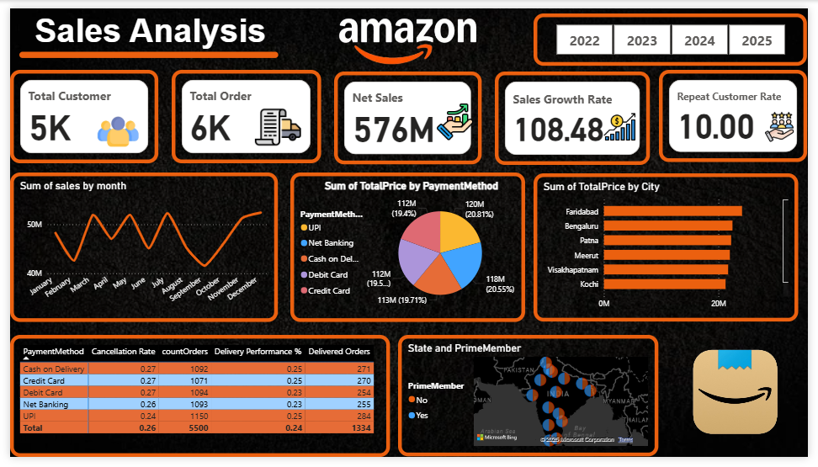

Slide 8
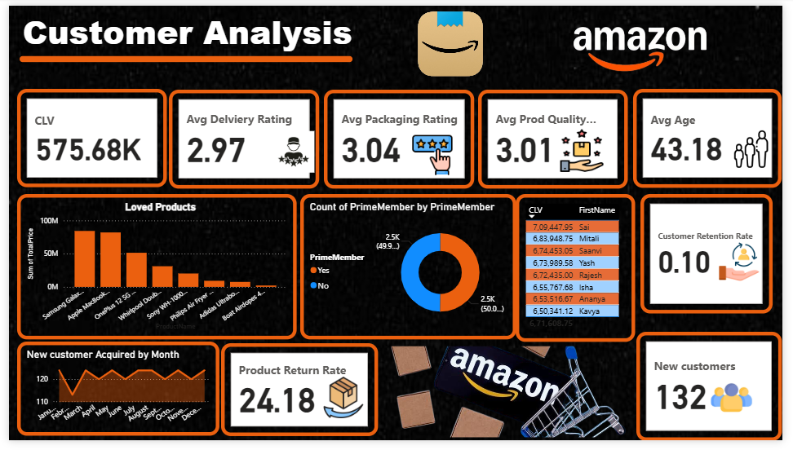

Slide 9
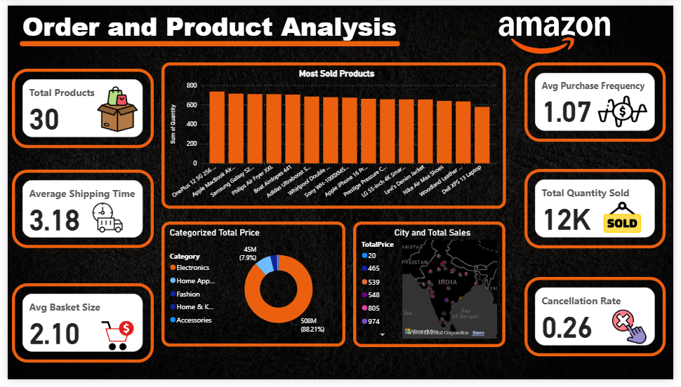

Slide 10


ANALYSIS THROUGH MYSQL

Slide 11
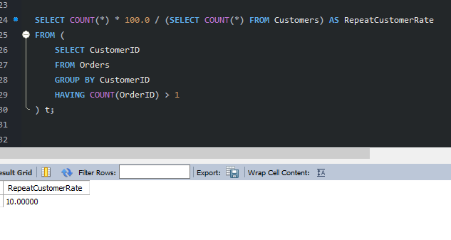
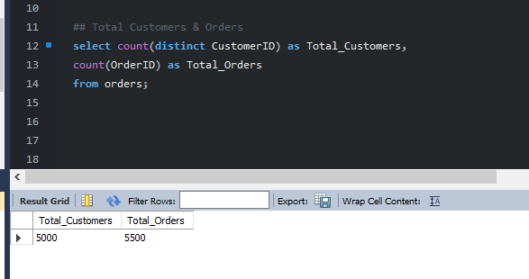


REPEAT CUSTOMER RATE
TOTAL CUSTOMER & ORDERS

Slide 12
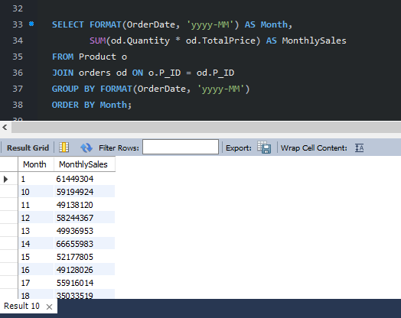
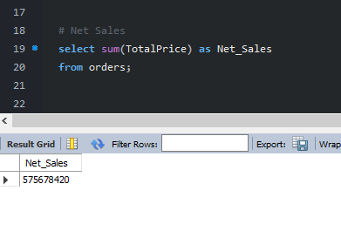


MONTHLY SALES
NET SALES

Slide 13
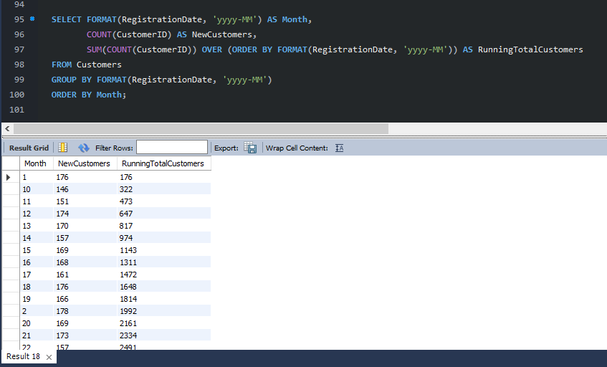
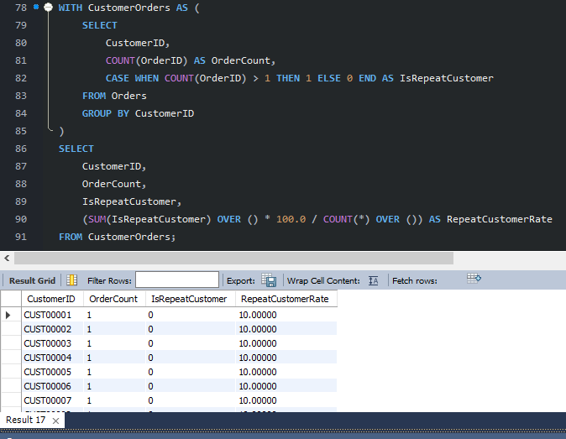


NEW CUSTOMER BY MONTH
REPEAT CUSOMERS

Slide 14
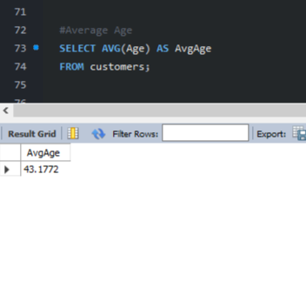
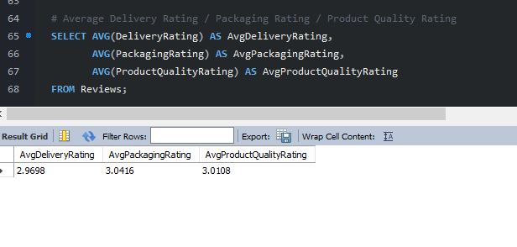


AVERAGE AGE
AVERAGE RATING

Slide 15
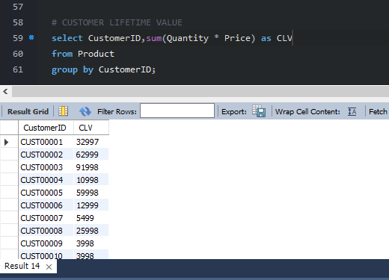
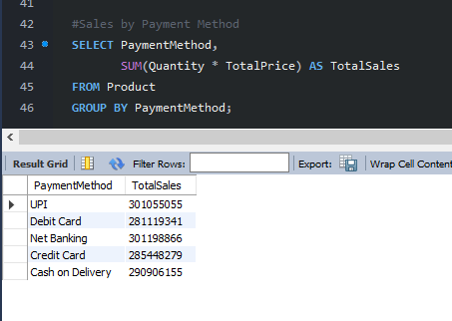


CUSTOMER LIFE TIME VALUE
PAYMENT WISE TOTAL SALES

Slide 16
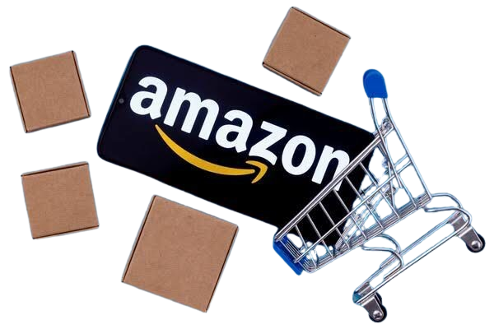
NET SALES $

Slide 17


ANALYSIS THROUGH PYTHON

Slide 18


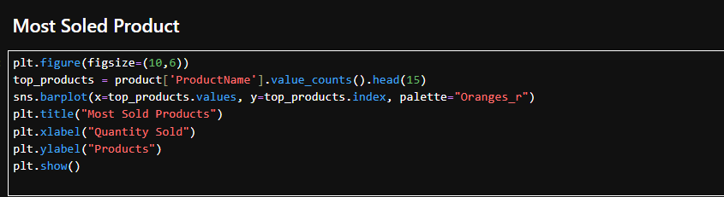
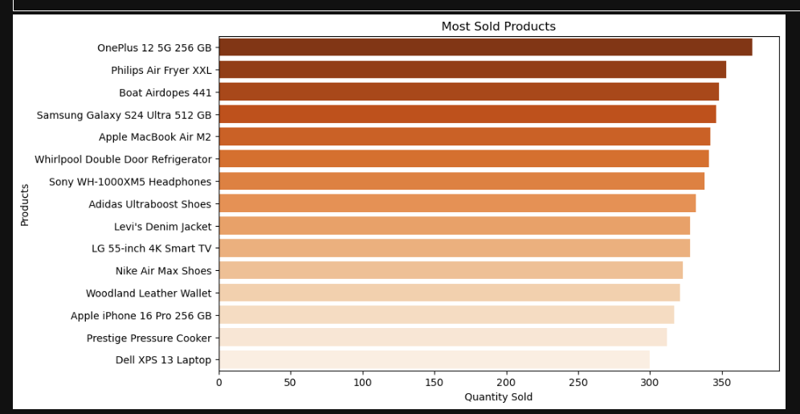
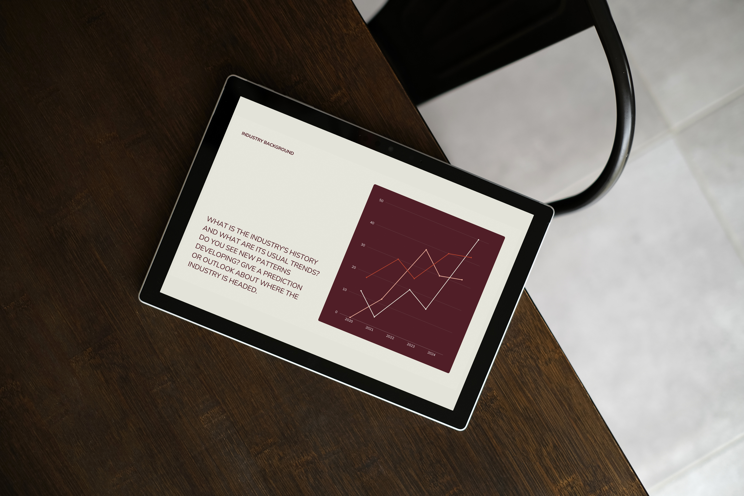

Slide 19
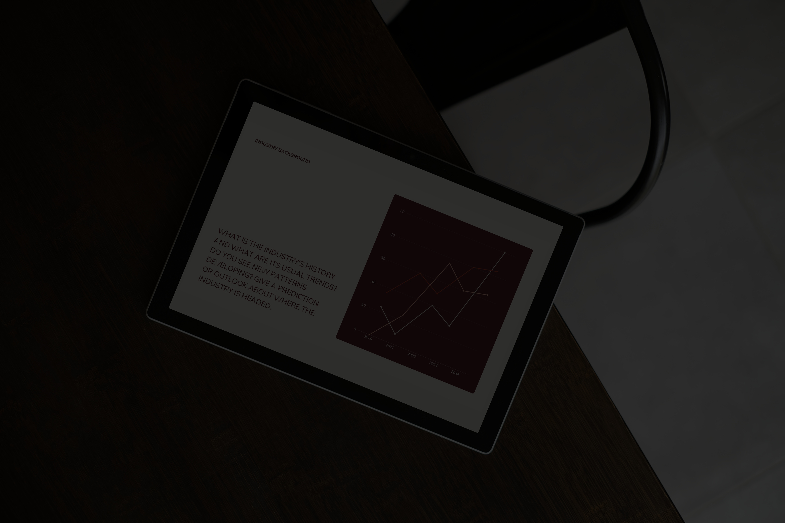
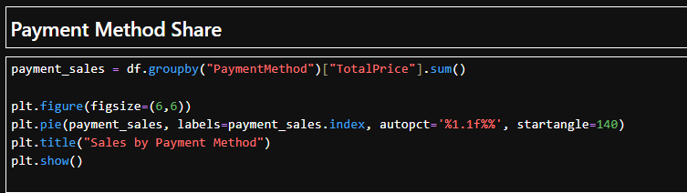
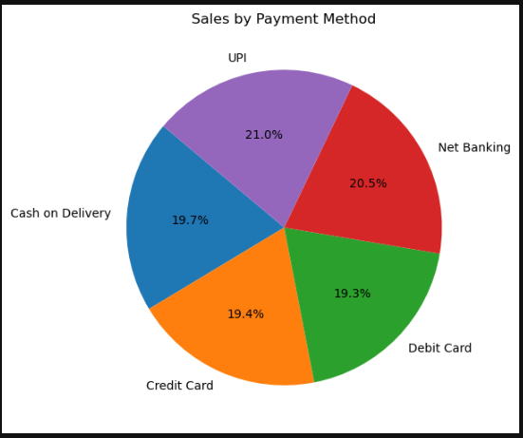


Slide 20
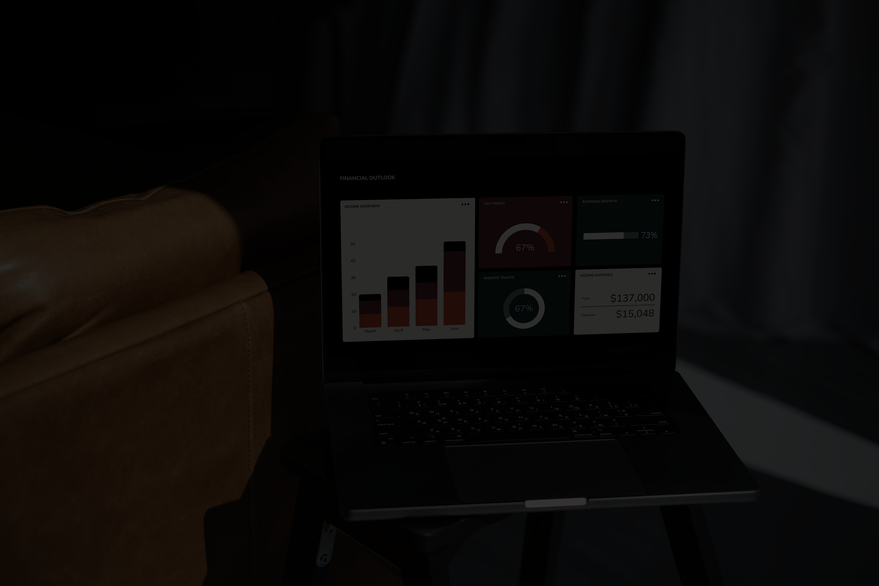
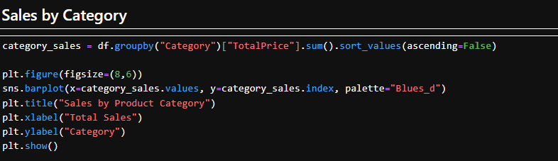
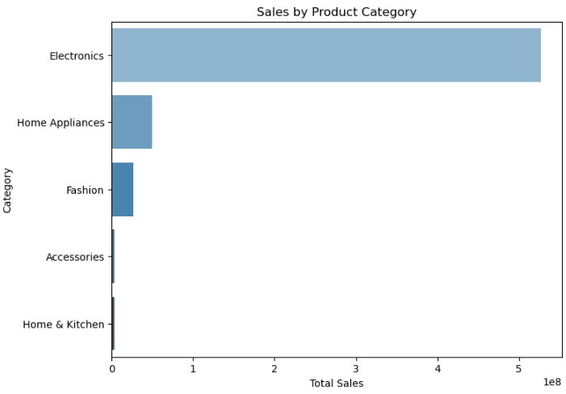


Slide 21
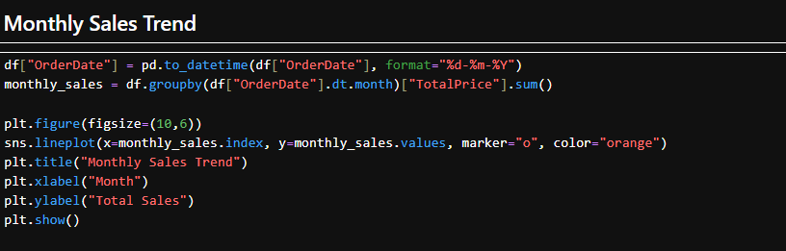
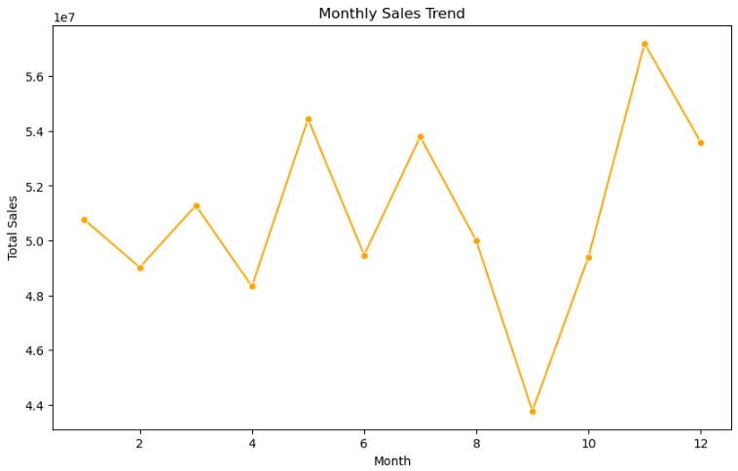

Slide 22
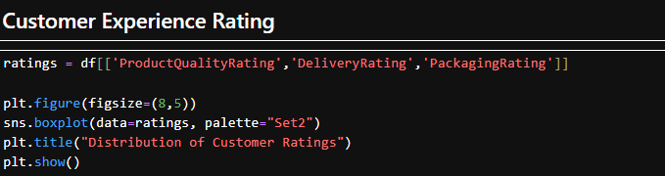
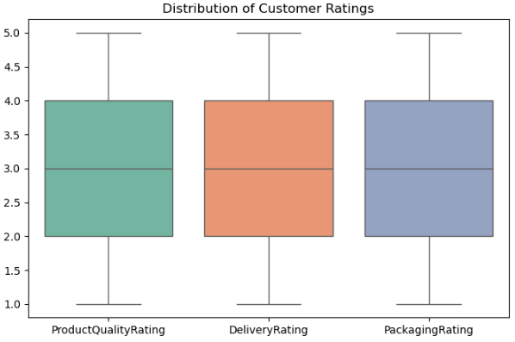

Slide 23
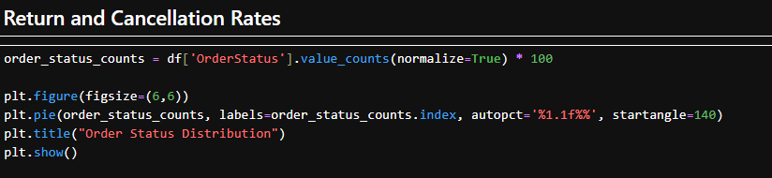
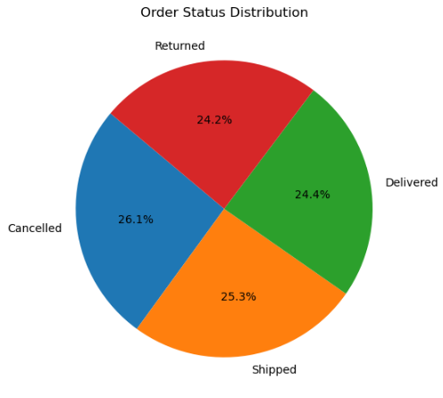


Slide 24
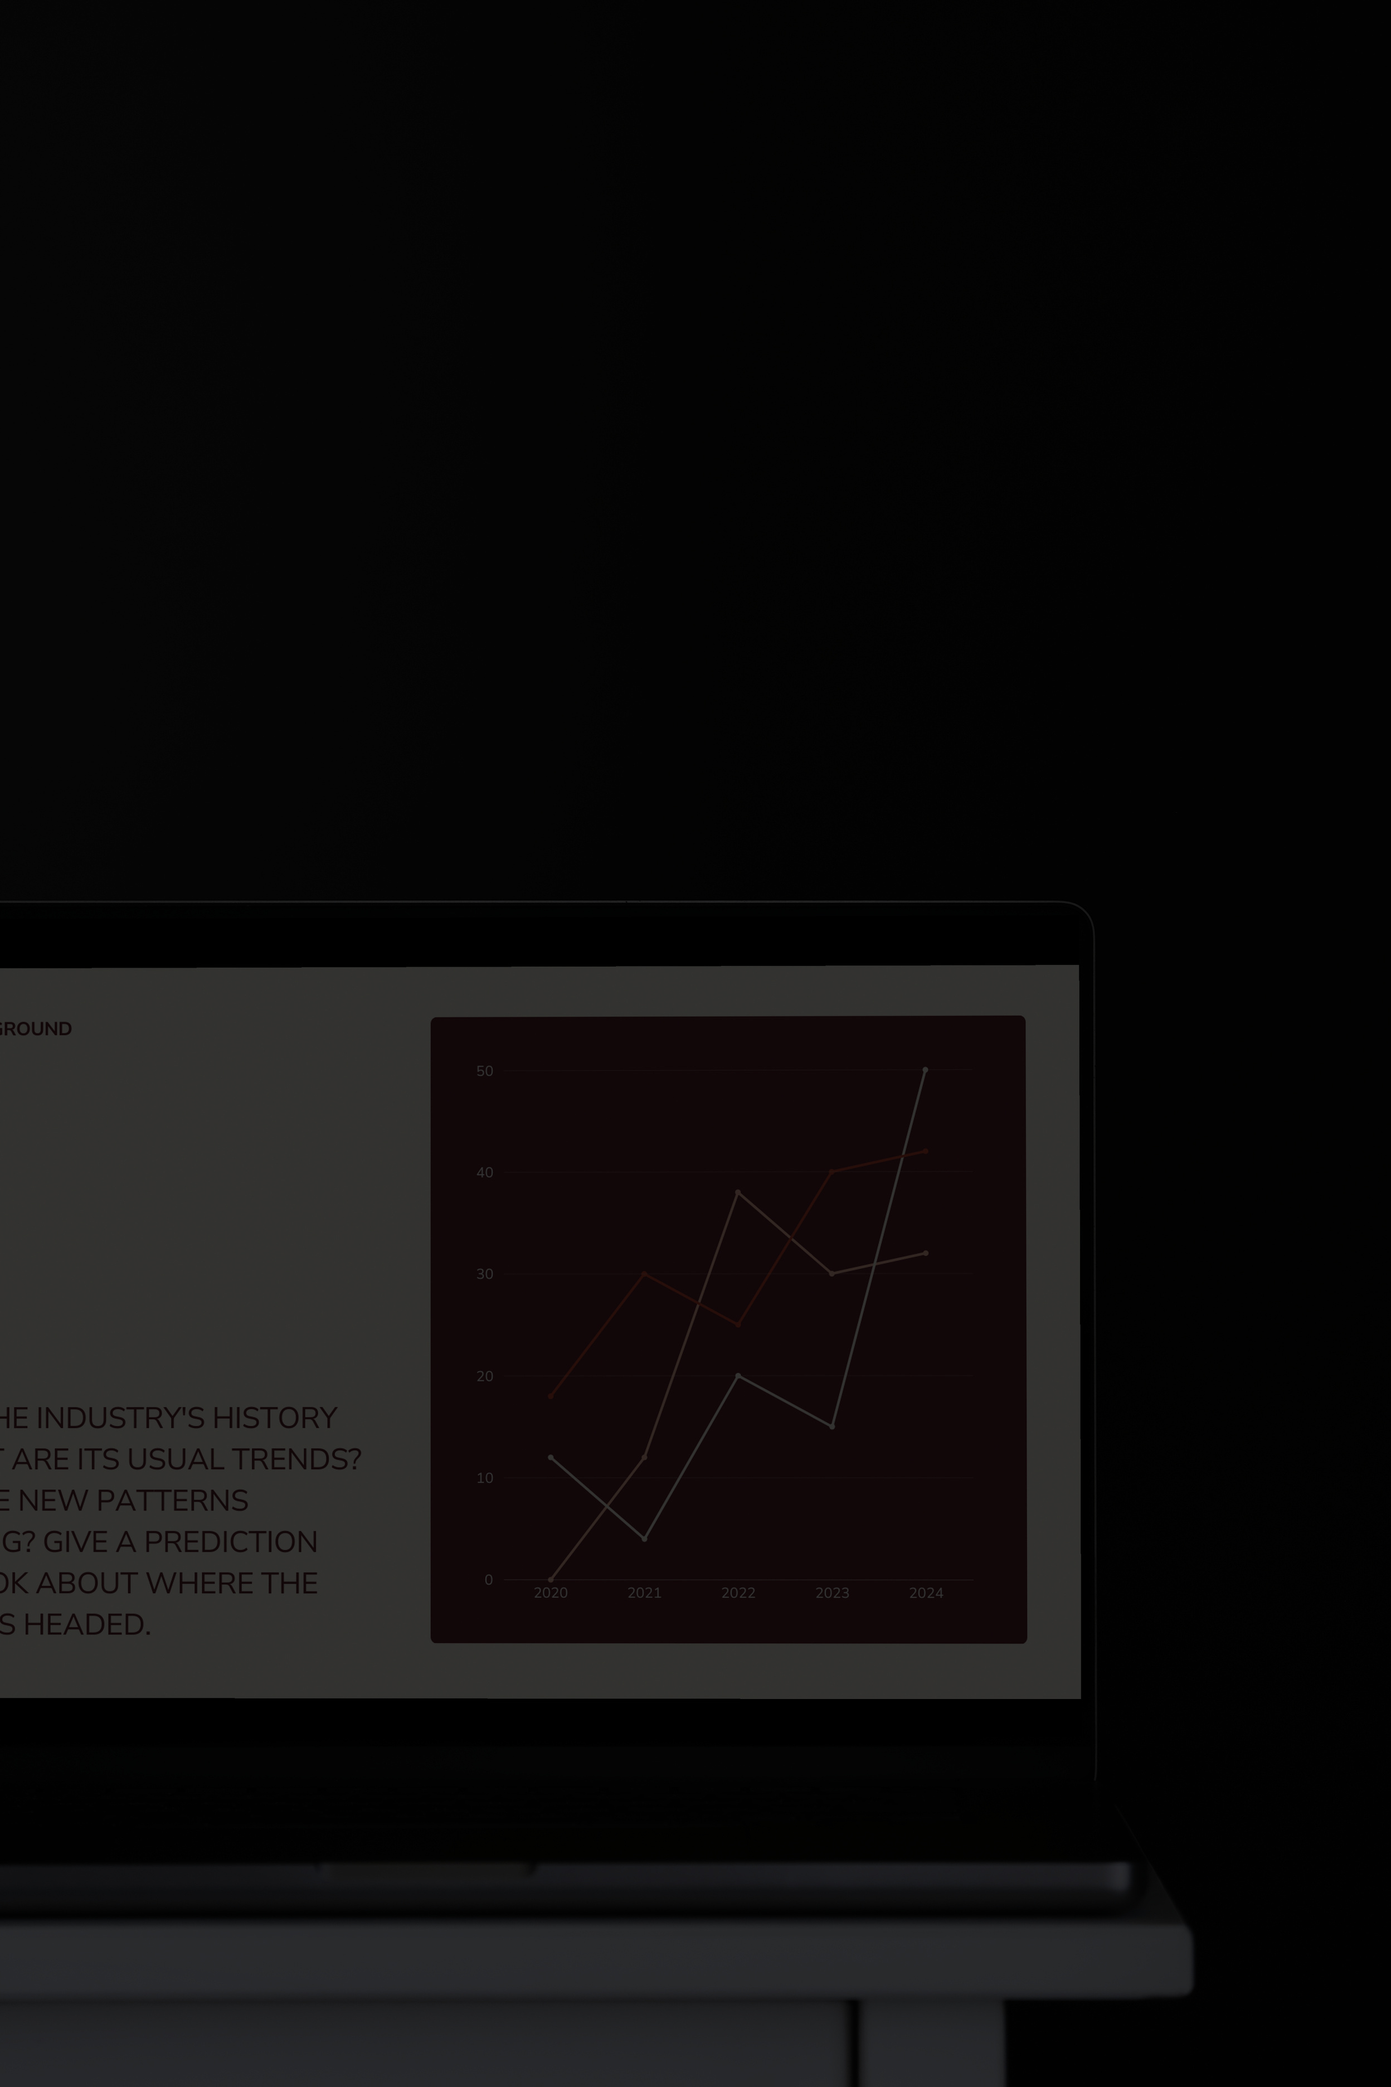
THANK YOU
FOR YOUR ATTENTION

